Slide 1
Addiction Treatment: Preventing Opiate Overdoses
David Sack, M.D.
Chief Medical Officer
Elements Behavioral Health

Slide 2
ASAM Disclosure of Relevant Financial Relationships Content of Activity: TSAM: Star Wars & Addiction Medicine
Name | Commercial Interests | Relevant Financial Relationships: What Was Received | Relevant Financial Relationships: For What Role | No Relevant Financial Relationships with Any Commercial Interests
Dr. David Sack | Elements Behavioral Health | Salary as CMO

Slide 3
Goals of Presentation
Which behaviors increase the risk of overdose in opiate dependent clients
Which factors differentiate clients with the highest risk for overdose?
How do treatment selection and clinical response influence overdose risk?
What clinical steps can be taken to lower overdose risk in the first year following treatment?

Slide 4
What Is An Overdose?
Accidental poisoning that may or may not result in death
Impaired consciousness/responsiveness
May involve one or more drugs
Is not the result of suicide attempt
Requires medical assistance (911, ER, friends) or would likely have resulted in medical attention if found

Slide 5
Why Do Opioid Abusers Die Of Overdoses?
Respiratory arrest
Aspiration and asphyxiation
Cardiac arrhythmia
Circulatory collapse
Rhabdomyolysis and kidney failure

Slide 6
Why Do People Overdose?
IV drug injection
Poly-substance abuse
Adulterants
Treatment effects - detox

Slide 7
IV Drug Injection
Rapid onset
Immediately goes to brain
Must use more frequently
Socially unstable environments

Slide 8
Why Does Treatment Increase OD Risk?
All Drugs Are Not The Same

Slide 9
How do neurotransmitters work?

Slide 10
What Is Tolerance?
When a drug is used repeatedly, the receptors become less sensitive to the drugs effects
Brain receptors try to compensate for the presence of a drug
Opioids that are used recreationally bind to the Mu Opioid receptor
Repeated exposure to opioids decreases the responsiveness of the u Receptor

Slide 11
Withdrawal/Detox
When a drug is discontinued the neurons involved are dysregulated, a state called allostasis
There is insufficient amount and response to the endogenous neurotransmitters
Gradually homeostasis is restored and tolerance is reversed
When someone is detoxed, they lose their tolerance for the drug

Slide 12
What is Detox?
Detox is a process where medications are administered to counteract withdrawal
The drugs used may directly replace the drug that was being taken (e.g. methadone, buprenorphine for opiates, diazepam or phenobarbarbital for alcohol)
Or drugs used may reduce a downstream effect of withdrawal (clonidine for opiates decreases arousal, anxiety, insomnia)

Slide 13
Detox Alone Is NOT Effective Treatment
Addicts refusing treatment and addicts going through detox have the same outcomes
Detox increases the risk of ODs
In a large treatment study of heroin addiction, only 1 out of 7 people were continuously abstinent for 12 months following treatment

Slide 14
Time to OD in Patients Who Stopped Naltrexone

Slide 15
If you want to arrive at your destination -
You first need to know where you are going.

Slide 16
Measures of Success in Addiction Rx
Continuous abstinence
Reduced use (% abstinent days, number of heavy drinking days, number of binges, # of drug free urines)
Retention in treatment
Quality of life
Employment status

Slide 17
What is a treatment failure
Death – overdose, suicides, all cause mortality
Incarceration
Medical complications: HIV, HEP C, medical hospitalization
Continuing drug use – for the target drug, for other drugs
Relapse back to previous use pattern

Slide 18
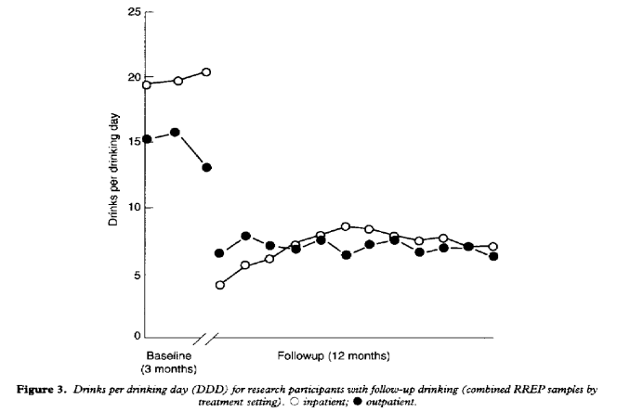
The Year Following Treatment – 2 Views
Time to First Drink
#Drinks Per Drinking Day

Slide 19
How Treatment Works
Continuous abstinence rates are 2-3 times higher following treatment
Among people who use there is a 50-60% decrease in consumption
Work attendance, self reported quality of life and healthcare utilization all show marked improvement after treatment

Slide 20
The Elements Outcomes Study
SPECIAL THANKS TO
GERARD CONNORS, PH.D. ADDICTION RESEARCH INSTITUTE, UNIVERSITY OF BUFFALO
STEPHEN A. MAISTO, UNIVERSITY OF SYRACUSE

Slide 21
Accepted for Presentation
American Association for Medical Education and Research in Substance Abuse, “Integrating Program Evaluation in a Private Addictions Treatment Environment: Implications for Clinical Practice”, Clare E. Campbell¹, Brenda To², Stephen A. Maisto¹, & Gerard J. Connors³ (Syracuse University¹; Elements Behavioral Health²; Research Institute on Addictions³ )
American Association of Addiction Psychiatry, “Conducting Systematic Program Evaluation in a Private Addictions Treatment Setting” . Clare E. Campbell¹, Brenda To², Stephen A. Maisto¹, & Gerard J. Connors³ , David A. Sack²

Slide 22
Measures
22
Dimension | Questions
Demographics | Age, gender, race Marital, employment statuses Overall health
Alcohol & Drug Use | Days used, abstinent Amount alcohol consumed, days heavy drinking Types of drugs used
Self-Help & Treatment Utilization | Days self help groups: AA, NA, CA, etc. Days detox, residential, outpatient treatment
Legal Involvement | Arrests Under influence
Internal Factors | Urges & craving Mood Overall life-functioning Readiness to change

Slide 23
Study Timeline and Procedures
Informed consent obtained with 5 days of admissions
Baseline assessment in person, f/u telephonic
Time frames
Baseline – 30 days prior to admission
Follow up at 1 month, 3 months and 6 months after discharge
Discharge = less than three days per week treatment
At least one collateral interview per subject AND whenever an interview could not be completed

Slide 24
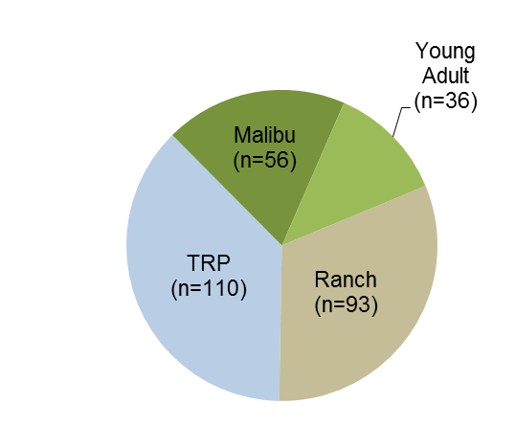
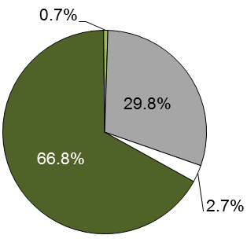
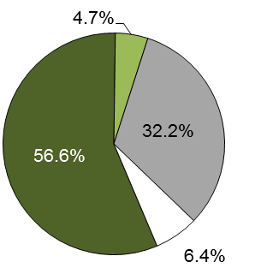
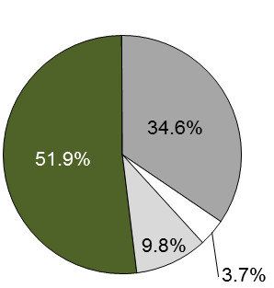
Participation Rates
24
Baseline
1 mo. F/U
3 mo. F/U
6 mo. F/U
Collaterals
295 interviews
199 interviews
69% of possible
182 interviews
65% of possible
181 interviews
66% of possible
153 interviews
60% of possible
Interviewed
Backup Interview
Unable to Reach
Do Not F/U
No Collateral

Slide 25
Patient Characteristics
 | The Recovery Place | Malibu | West LA | The Ranch
Age (yrs.) | 27.1 | 41.2 | 24.3 | 30.9
Education (yrs.) | 13.0 | 15.0 | 14.3 | 14.9
Gender (% male) | 63% | 57% | 68% | 43%
Marital Status (married/cohab) | 17% | 45% | 0% | 22%

Slide 26
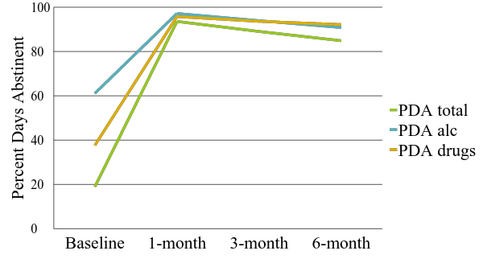
Percent Days Abstinent (Combined Centers)

Slide 27
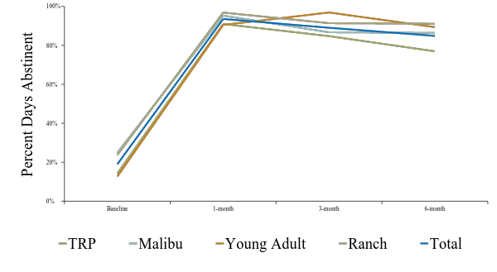
Positive Outcomes At Every Program

Slide 28
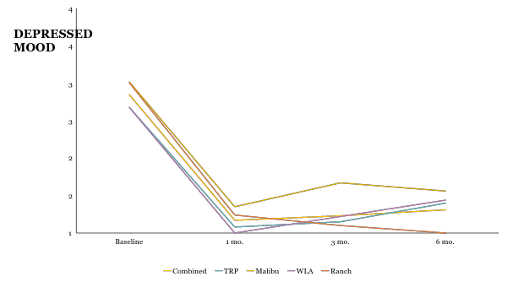
Clients Are Less Depressed

Slide 29
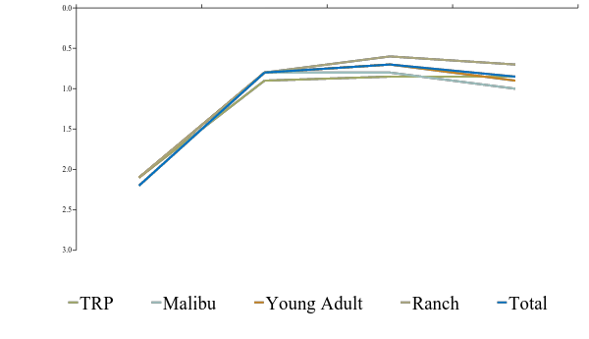
Quality of Life Improves
Wellness

Slide 30
So if drugs and alcohol had similar outcomes -
Why do we need different treatments?

Slide 31
Clinical Differences Between Alcohol and Opioids
Alcohol | Opiates
Overdose deaths in alcoholics rare | OD deaths common and increasing
Pharamcotherapy minimally effective | Pharamcotherapy moderately effective
Rx decreases craving, decrease reward | Rx Blocks high or Induces massive tolerance
CBT, MI, IPT all effective | Contingency management and Community Reinforcement
OD deaths rare after relapse | OD Peak within 2 weeks of relapse

Slide 32
What are we treating and why are we treating it?

Slide 33
What is addiction?
A disorder of the brain’s reward system
A spiritual malady of self-centeredness
Genetic disease of impulsivity
An expression of poor nurturance, abuse, neglect
An attempt to cope with intra-psychic distress

Slide 34
Great Moments in the Treatment of Addictions
1884
Freud introduces Cocaine as a treatment for Morphine addiction
1898
Bayer markets Heroin as a cure for Morphine addiction.
1957
Librium discovered. Its value in detoxification leads to it misuse for alcohol dependency
Notes:
Naltrexone for alcohol = freud
Methadone for Heroin
Chantix for alcohol

Slide 35
How might addiction treatments work?
Decrease craving
Block pleasure
Decrease abstinence syndrome
Interfere with social reinforcement

Slide 36
Chronic Drug Use Injures The Brain
Dopamine sensitization and drug induced psychosis
Cue induced stress responses
Memory disturbances
Impulsivity
Disrupted self-regulation (sleep, appetite, energy)
Limited capacity for caring (alexithymia)

Slide 37
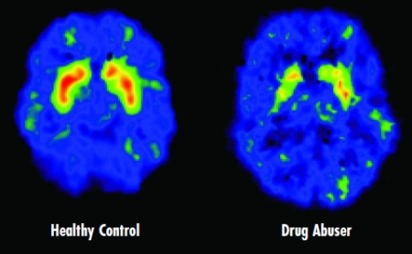
Long term changes in DA
Marked decrease in DAT in long term amphetamine abuser
Cocaine and amphetamine psychoses recur after a singe use

Slide 38
Approved Treatments For Opiate Dependency
Methadone
Full μ receptor agonist
Binds and activates receptor
Naltrexone
Full antagonist
Binds and blocks activation
Naloxone
Full antagonist – OD rescue medication
IM, IV or infranasal
Buprenorphine (Subutex, Suboxone)
Partial agonist
Binds and activates with ceiling effect
Notes:
Dependency as opposed to detoxification
Promises does not use agonist based opiate treatments

Slide 39
Relative Effects on Opioid Receptor
Notes:
Why is the full agonist Methadone better than just giving heroin?

Slide 40
Methadone
Mu opioid receptor agonist
Long half life
Cross substitutes
Blocks withdrawal and craving
Blocks the high of self administered opiates
Suppresses Heroin use
Increases the number of clients retained in treatment
Improves social indices: crime, work, quality of life

Slide 41
How does Methadone differ from Heroin?
Slow absorption, long half life
High affinity for the receptor and slow dissociation
Less euphoria, little craving, blocks the high of heroin

Slide 42
How well does Methadone work?

Slide 43
Buprenorphine
Partial agonist with very high affinity for and low dissociation from the mu receptor
Sublingual tablets (poorly absorbed from the gut), buccal film
There is a ceiling effect so that increasing the dose above a threshhold has NO additional effect
Greatly reduces the risk of an overdose
Suboxone containes buprenorphine + naloxone in a 4:1 ratio (decreases abuse potential)
Reduces use of illicit opiates
Clients were retained in treatment

Slide 44
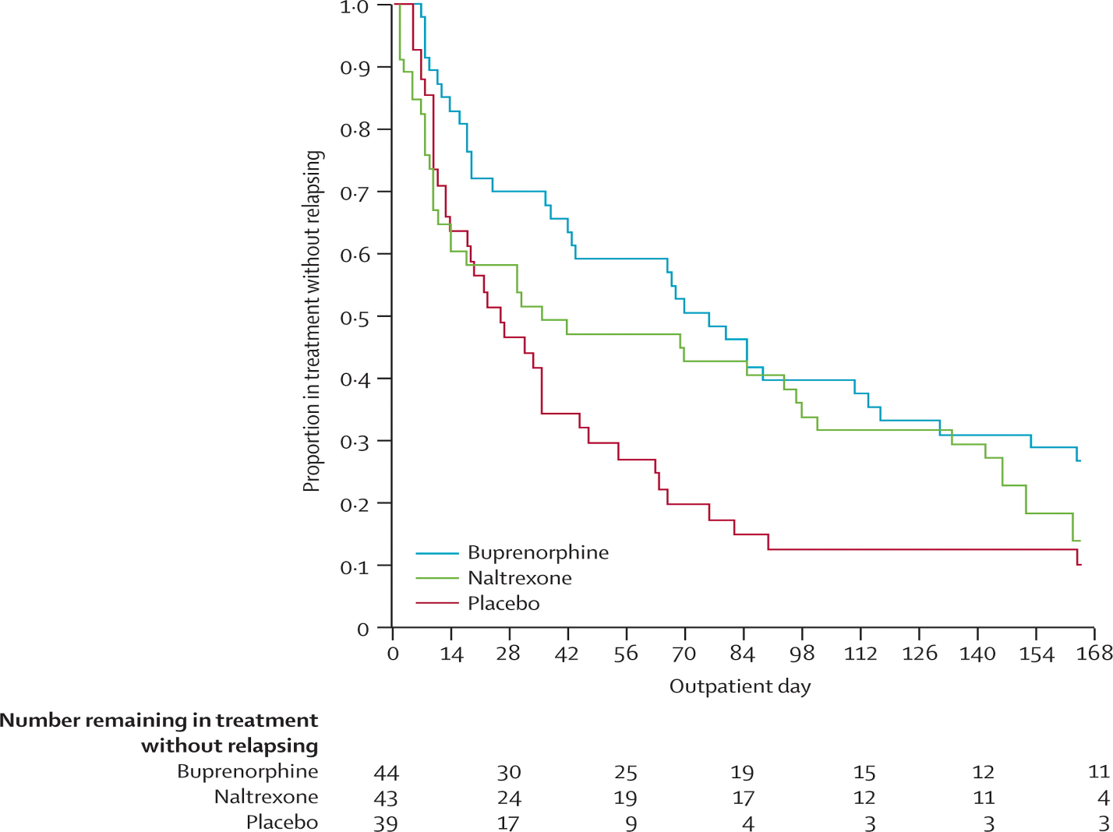
Naltrexone and Buprenorphine Compared

Slide 45
Summary
Methadone is more effective than Buprenorphine.
IM Naltrexone appears to be comparable to Buprenorphine in preventing relapse to heroin use
Oral Naltrexone is less effective than eith Methadone or Buprenorphine and is associated with higher risk of OD and death

Slide 46
All Opioid Users Are NOT The Same
Factors associated with Overdoses and relapses

Slide 47
A 1980 Solution For a 2017 Problem

Slide 48
Demographics and Opioid OD
Men > Women
< 25 years old

Slide 49
Drug Behaviors Linked to Opioid ODs
Injecting drugs
Other Drugs: Cocaine, Alcohol, Benzodiazepines
Arrests other than for drug possession

Slide 50
Treatment Factors and Opioid ODs
Number of treatments in the last 12 months
Length of sobriety following treatment <6 months
History OD last 6 months, ever
Narcan, paramedics, ER, hospital

Slide 51
Symptoms Associated with Increased OD
Craving intensity/frequency
Readiness for Change

Slide 52
Single Item Visual Analog Scales

Slide 53
Putting It All Togther
A clinical scale to measure OD and relapse risk

Slide 54
Initial Experience with Scale

Slide 55
Key Client Observations
Past Overdoses: 30%
IV drug use: 35%
Benzodiazepines: 60%
Arrest (other than possession): 40%
Failed treatment: 40% (most often within 6 months)

Slide 56
Detox and Treatment
Clients in the highest risk group may not be candidates for detox
If they are detoxed, they need to placed on treatment that will mitigate their risk for OD and relapse
Detox followed by discharge increases the risk for OD

Slide 57
Ensuring Opiate Clients Get Medications

Slide 58
Clients Vary Markedly In Their OD Risk
Programs need to identify clients at the highest risk for Overdose
High risk clients should not be treated in an abstinence only model (Wishing, Hoping, Praying)
Clients should be educated as to all of the effective treatments for opiate dependency

Slide 59
What Doesn’t Work?
Detox by itself
No better than no treatment
Medications for cocaine, stimulants
Oral naltrexone for opiate dependency – OD risk

Slide 60
One final thought..
What’s the difference between a dog?
Its two left feet are not the same.

